Slide 1
Computers Principles 13Lecture/الأنظمة العددية ( الترقيم )
Civil Engineering Department College of Engineering / Diyala University/ 2016-2017.
Dr. Qasim Adnan Aljanabi

Slide 4
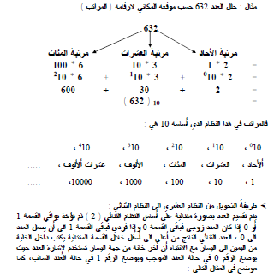

Slide 5
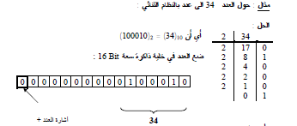
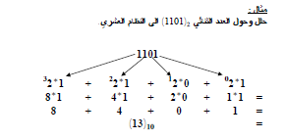

Slide 6
THANK - YOU

